Slide 1
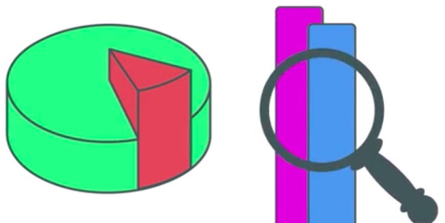
Data Science 101
Day 3: Basic Mathematics

Slide 2
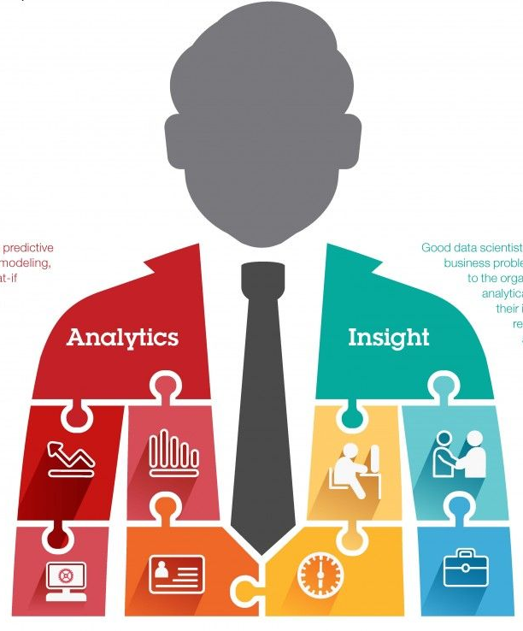
About Me
Join us: https://www.linkedin.com/groups/6707800/
Twitter: https://twitter.com/Sanjeet36284331
Linkedin: https://www.linkedin.com/in/sanjeetshukla/
Sanjeet Shukla
Data Scientist-Big Data
Cognizant Technology Solutions

Slide 3
Additional Reading
https://stattrek.com/statistics/charts/histogram.aspx?Tutorial=AP

Slide 4


